Slide 1
The Giving Tree Wildcat Style
Rockbridge County High School

Slide 2
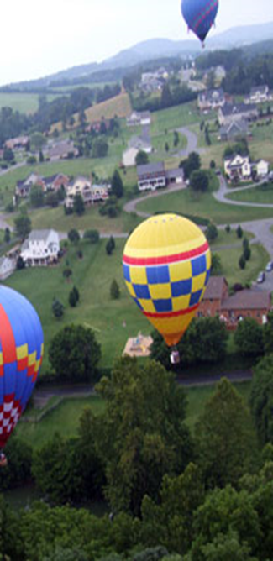
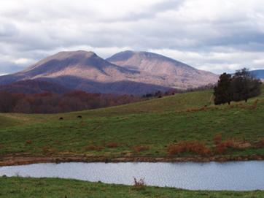
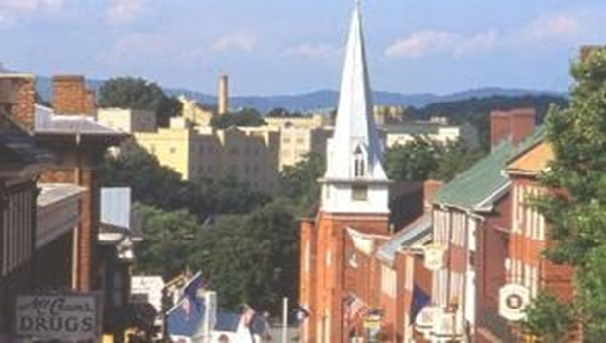
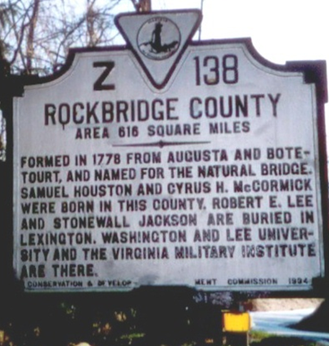
The Background

Slide 3
Our School

Slide 4
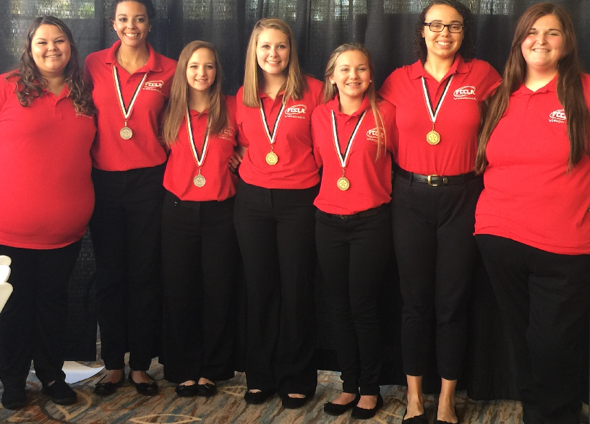
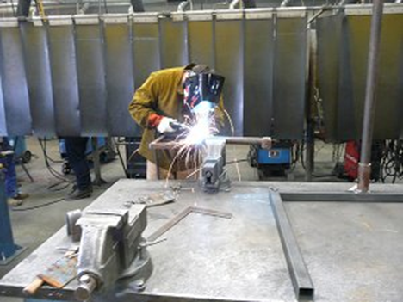
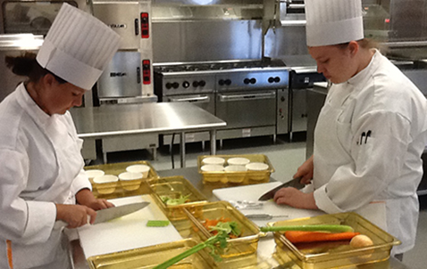
What Makes Us Unique:
1000 students from grades 9 thru 12
We have a diverse student population
Our Vocational School attaches to our High School

Slide 5
So What is the Giving Tree…
A “store” where our peers who need clothing, food, school supplies etc. can put in a request to receive help
The request is processed and they receive needed items
Our goal is to make a difference in someone’s life by taking a possible stressful situation and making it better through providing basic needs.
In turn allowing them to concentrate on their school performance.

Slide 6
How did we get involved…
Through our work with the after school group CAT-Tagious…The Giving Tree was Created
Our theme this year is Wildcat Strong and with this project our Wildcat Family is becoming stronger

Slide 7
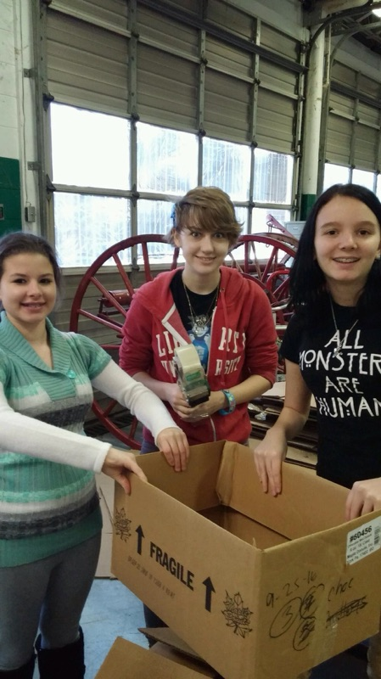
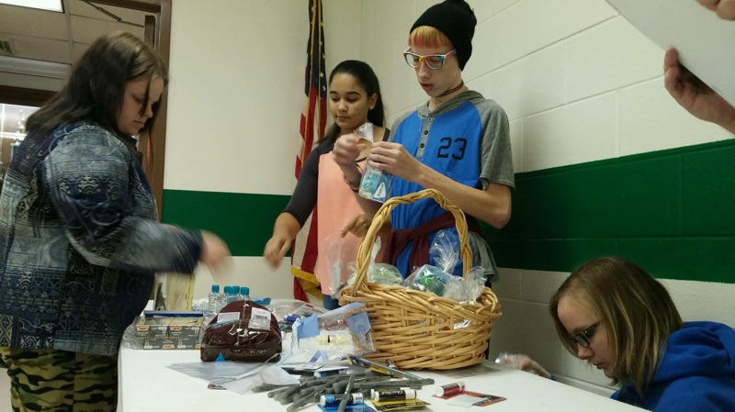
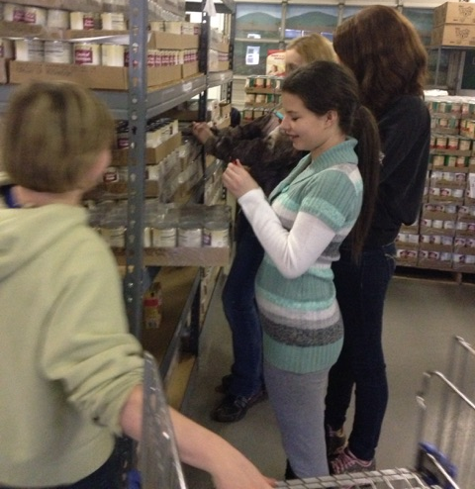
How We Collected Supplies
Homecoming Supply Drive
Have-A-Heart Supply Drive

Slide 8
Collaborative Groups
Life Skills Class
Agriculture Business Classes
CAT-Tagious
Washington & Lee University

Slide 9
The Future
Our future goal is that The Giving Tree will become a lasting tradition on our campus

Slide 10
Questions…

