Slide 1
Robert E. Lee High School
Staunton, Virginia

Slide 2
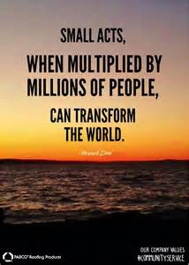

Slide 3
Community service during homecoming week
We believe that our high school is not only a place for learning but the flagship of our community. In order to build positive relationships, we want to give back to the community that supports us.

Slide 4
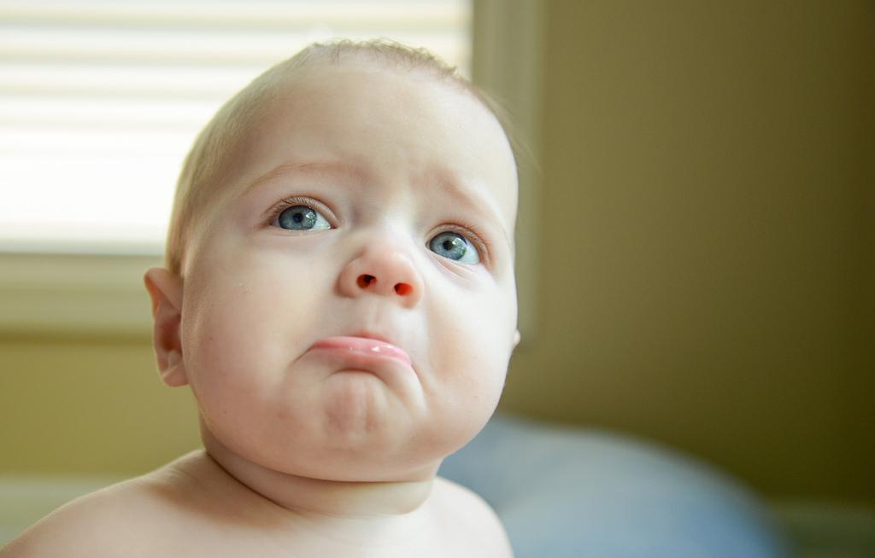
The plan
It began with a group of 8 individuals who wanted to improve the image of high school students in the community.
Let’s face it. As high school students we often get a bad rep.

Slide 5
Next
We met with our administrator and brainstormed ways that we could improve our image and community service was suggested. The first year, about 20 students went out into the community and discovered the value of giving back. They wanted others to also have the chance to give back and so we initiated 2 community service days at our school. One in the fall during HOMECOMING and one in the spring. Last year, we participated in over 100 projects and are on target to do the same this year.

Slide 6
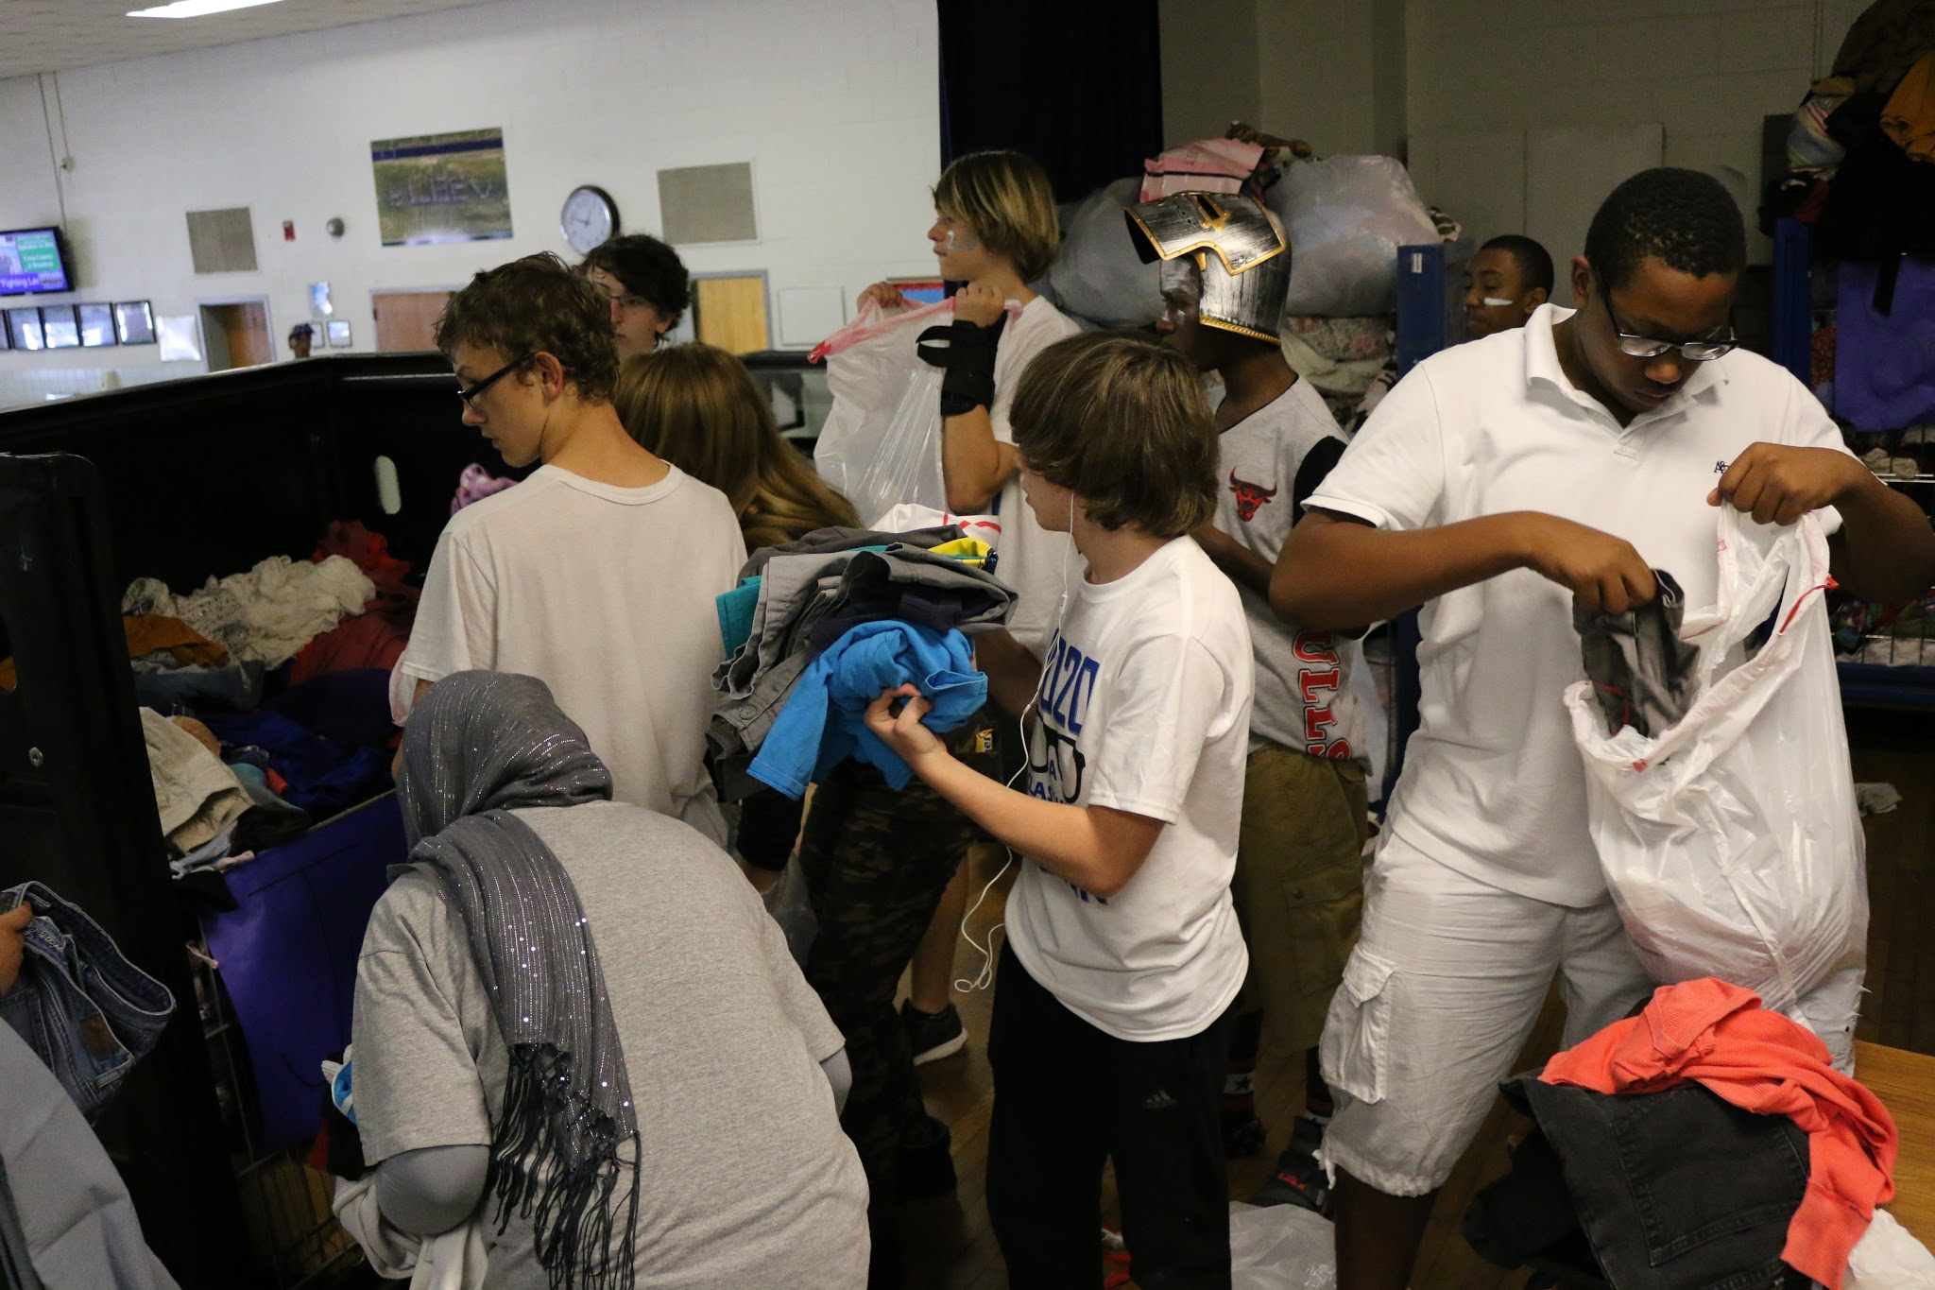
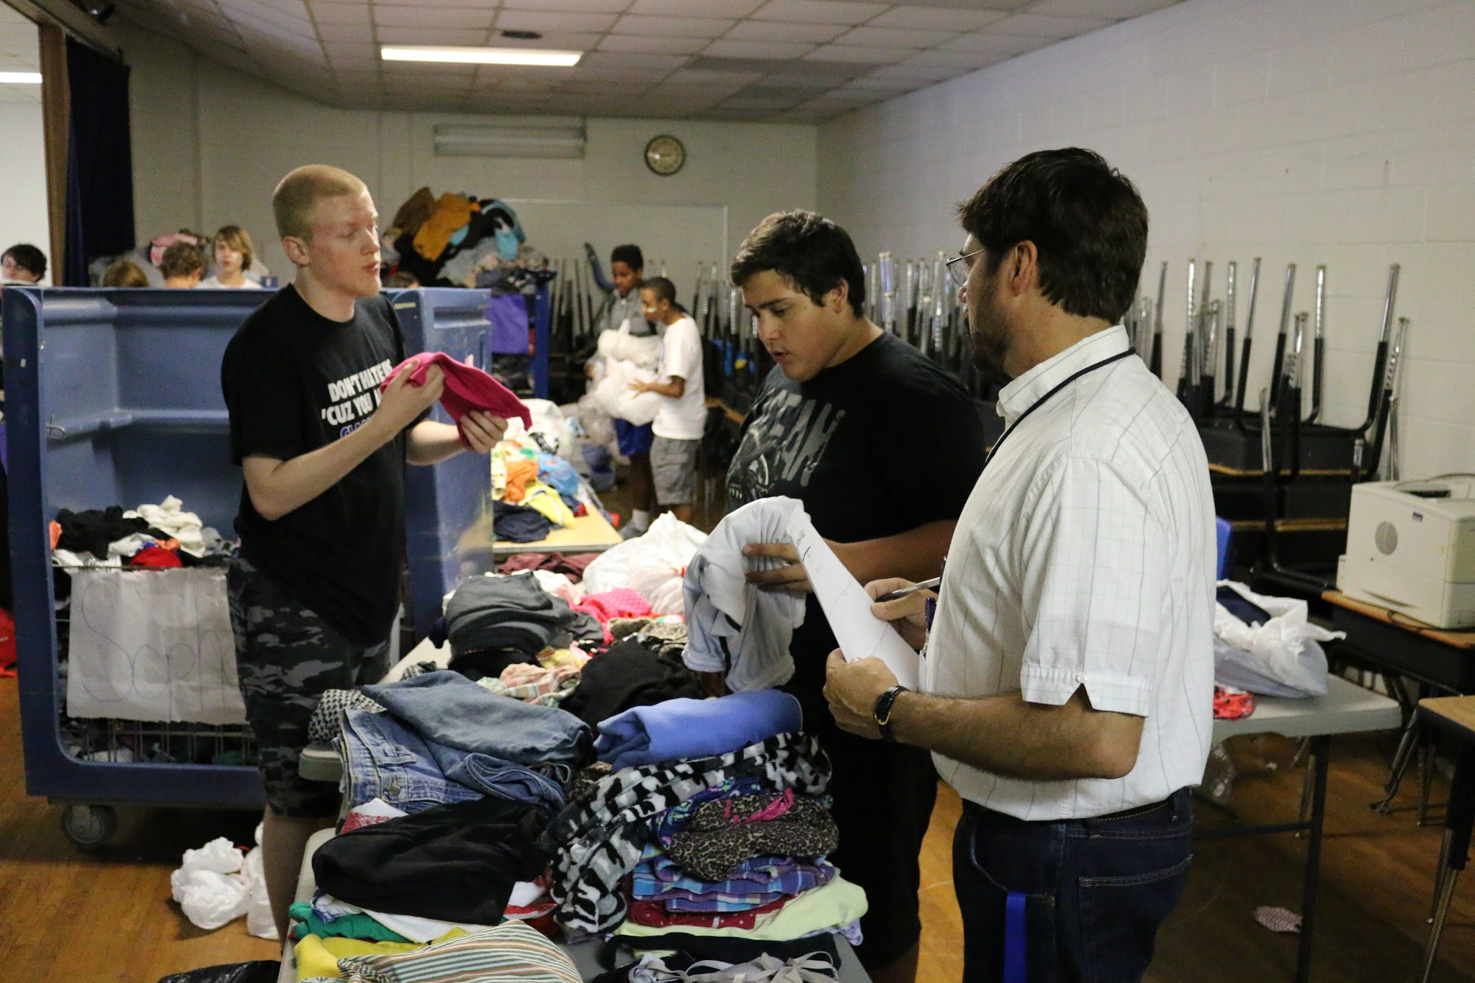
School wide projects

Slide 8
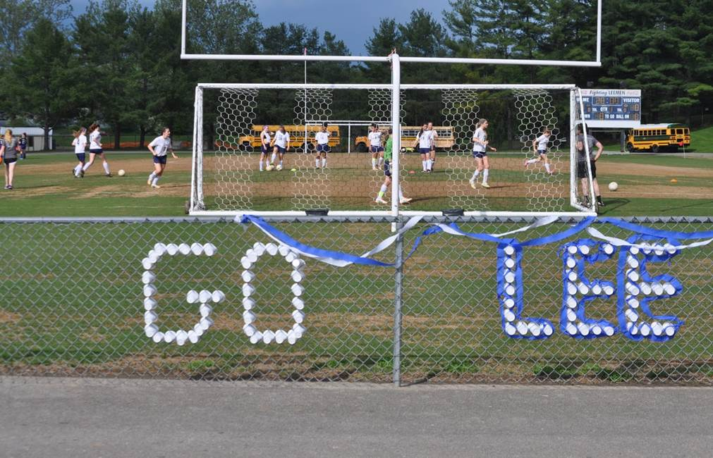
We BeLEEve that we can make a difference

