Slide 1
Orange County High School

Slide 2
Senior Mentors
For the class of 2020

Slide 3
What?
Freshman Induction Program

Slide 4
Who?
40 seniors
Notes:
40 seniors were chosen by a group of counselors, administrators & staff in the early summer.

Slide 5
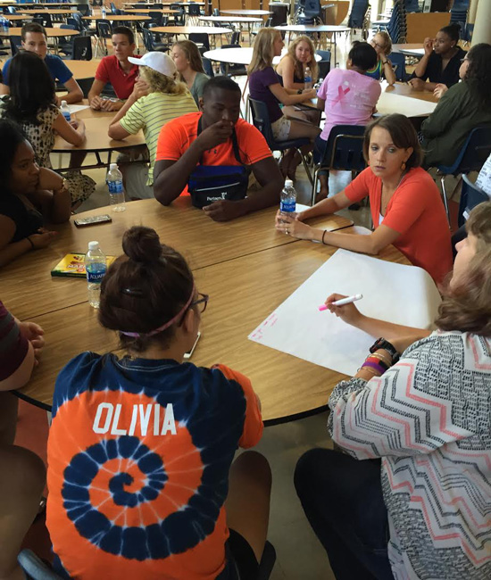
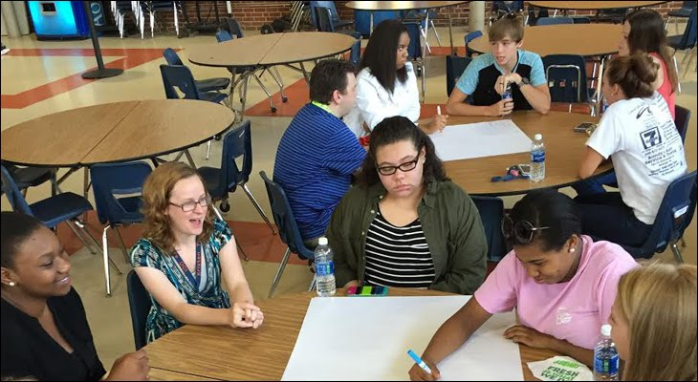
When?
Senior Mentor Workshop
August 8, 2016
Notes:
Counselors worked with students at the senior mentor workshop training on August 16, 2016

Slide 6
How?
Divided into groups
Notes:
The Freshman Class was divided into groups of 24 or” homerooms” alphabetically by last name. Then they were divided into
smaller groups with 8-10 people in each group & linked to one of the Seniors,

Slide 7
What next?
Hornet Homeroom
Notes:
One Friday a month we have a Hornet Home room period. There is a block of time after 2nd block that allows us to have a club day or this home room. The senior mentors go to the homeroom of the group assigned to them & meet.

Slide 8
Let’s get started
Meeting 1: Expectations
&
Ice Breakers
Notes:
Introductions of mentor & mentees: hobbies , interests-
Ground rules-suggestions from mentees

Slide 9
Goals
Problems or questions
Notes:
Goals mentee has set for the high school experience: diploma type
What is said here stays here.

Slide 10
Upcoming events
Clubs
Notes:
Sports
Orange & blue club options

Slide 11
Meeting 2:
Resources
Notes:
Name game
Questions about activities, sporting events, clubs, regrets?
Resources: teachers, Check grades & assignments, Powerschool information, Study Table, Front Office-behind the wheel or parking pass,Attendance, Nurse, Library, Counseling Center, School e-mail, Peers, on-line resources
(handout provides other resources

Slide 12
Voting
For
Homecoming Court
Notes:
Show how ballots are used

Slide 13
Meeting 3:
academic Success
Notes:
Mentor check in-what resources have they used. Diplomas, SOLs, verified credits, report cards, GPA,
How zeros play a role

Slide 14
Setting Goals
Notes:
Create some academic goals
SMART

Slide 15
Questions

